Slide 1
Temperature Regulation and Monitoring
Moderator : Dr Anil Kumar
Presenter: Dr Ramya Bhavana

Slide 2
Definitions
Temperature
It is the thermal state of a substance which determines whether it will give heat to another substance or receive heat from it.
Heat
Heat is a form of energy that can be transferred from a hotter substance to a colder substance.
The average normal core temperature is generally considered to be between 98.0°F and 98.6°F and about 1°F higher when measured rectally.

Slide 3
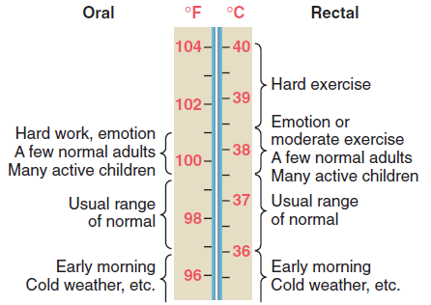

Slide 4
Units of Measurement of Temperature
Celcius Scale
Farenheit Scale
Kelvin scale

Slide 5
Normal Thermoregulation
Thermoregulation is similar to many other physiologic control systems in that the brain uses negative and positive feedback to minimize perturbations from preset, “normal” values.
Thermoregulation is based on multiple, redundant signals from nearly every type of tissue. The processing of thermoregulatory information occurs in three phases:
afferent thermal sensing
central regulation
efferent responses.
Body temperature is controlled by balancing heat production and heat loss.

Slide 6
Afferent Input
Cold signals travel primarily via Aδ nerve fibers and warm information by unmyelinated C fibers, although some overlap occurs.
Most areas of the body have 3 to 10 times as many cold spots as warmth spots.
Most ascending thermal information traverses the spinothalamic tracts in the anterior spinal cord, but no single spinal tract is critical for conveying thermal information.
The hypothalamus, other parts of the brain, the spinal
cord, the deep abdominal and thoracic tissues, and
the skin surface each contribute roughly 20% of the total thermal input to the central regulatory system

Slide 7
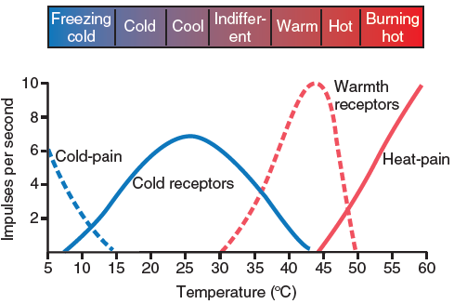

Slide 8
Central Control
Temperature is regulated by central structures (primarily the hypothalamus) that compare integrated thermal inputs from the skin surface, neuraxis, and deep tissues with threshold temperatures for each thermoregulatory response.
How the body determines absolute threshold temperatures is unknown, but the mechanism appears to be mediated by norepinephrine, dopamine, 5-hydroxytryptamine, acetylcholine, prostaglandin E1, and neuropeptides.

Slide 9
Gain and Maximum Intensity
The slope of response intensity versus core temperature defines the gain of a thermoregulatory response.
Response intensity no longer increasing with further deviation in core temperature identifies the maximum intensity.

Slide 10
Efferent Responses
Each thermoregulatory effector has its own threshold and gain, so an orderly progression of responses and response intensities occurs in proportion to need.
In general, energy-efficient effectors such as vasoconstriction are maximized before metabolically costly responses such as shivering are initiated.

Slide 11
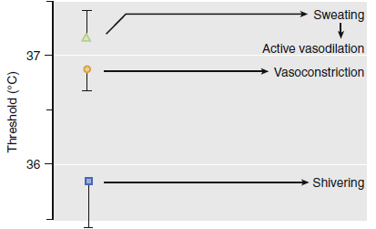

Slide 12
Effectors determine the ambient temperature range that the body will tolerate while maintaining a normal core temperature.
When specific effector mechanisms are inhibited (e.g., when shivering is prevented by administration of muscle relaxants), the tolerable range is decreased. Sustained shivering augments metabolic heat production by 50% to 100% in adults.
Nonshivering thermogenesis increases metabolic heat production (measured as whole-body oxygen consumption) without producing mechanical work.
Sweating is the only mechanism by which the body can dissipate heat in an environment exceeding core temperature. Fortunately, the process is remarkably effective, dissipating 0.58 kcal/g of evaporated sweat.

Slide 13
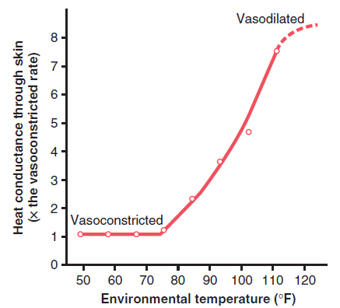

Slide 14
THERMOREGULATION DURING GENERAL ANESTHESIA
All general anesthetics tested thus far markedly impair normal autonomic thermoregulatory control. Anesthetic induced impairment has a specific form: warm-response thresholds are elevated slightly, whereas cold-response thresholds are markedly reduced.
Consequently, the interthreshold range is increased from its normal values near 0.3° C to approximately 2° C to 4° C

Slide 15
RESPONSE THRESHOLDS
Propofol , alfentanil , and dexmedetomidine all produce a slight, linear increase in the sweating threshold combined with a marked and linear decrease in the vasoconstriction and shivering thresholds.
Isoflurane and desflurane also slightly increase the sweating threshold; however, they decrease the cold-response thresholds nonlinearly.
Consequently, the volatile anesthetics inhibit vasoconstriction and shivering less than propofol at low concentrations, but more than propofol at typical anesthetic doses.
In all cases (except after meperidine and nefopam administration), vasoconstriction and shivering decrease synchronously and maintain their normal approximate 1° C difference.
Clonidine synchronously decreases cold-response thresholds, while slightly increasing the sweating threshold.
Nitrous oxide decreases the vasoconstriction and shivering thresholds less than equipotent concentrations of volatile anesthetics.

Slide 16
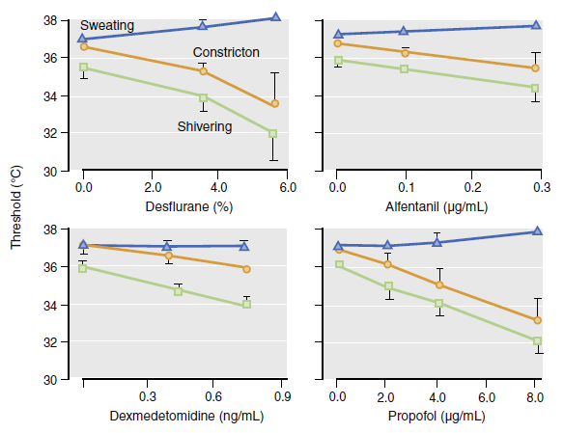

Slide 17
GAIN AND MAXIMUM RESPONSE INTENSITY
Both the gain and maximum intensity of sweating remain normal during isoflurane and enflurane anesthesia.
However, the gain of arteriovenous shunt vasoconstriction is reduced threefold during desflurane anesthesia even though the maximum vasoconstriction intensity remains normal.
Gain and maximum shivering intensity remain normal during both meperidine and alfentanil administration.
Sweating is the best preserved major thermoregulatory defense during anesthesia. Not only is the threshold only slightly increased, but the gain and maximum intensity remain normal.

Slide 18
DEVELOPMENT OF HYPOTHERMIA DURING GENERAL ANESTHESIA
Heat can be transferred from a patient to the environment four ways:
Radiation
(2) conduction
(3) convection
(4) Evaporation
Among these, radiation and convection contribute most to perioperative heat loss.

Slide 19
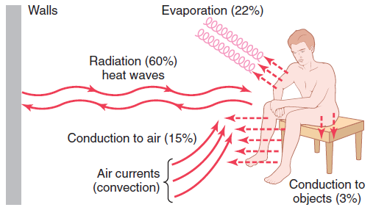

Slide 20
PATTERNS OF INTRAOPERATIVE HYPOTHERMIA
Hypothermia during general anesthesia develops with a characteristic pattern. An initial rapid decrease in core temperature is followed by a slow, linear reduction in core temperature. Finally, core temperature stabilizes and subsequently remains virtually unchanged.

Slide 21
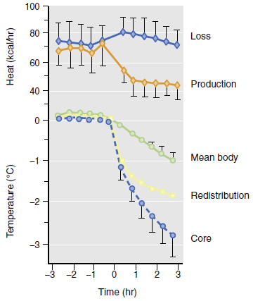

Slide 22
NEURAXIAL ANESTHESIA
Autonomic thermoregulation is impaired during regional anesthesia, and the result typically is intraoperative core hypothermia. This hypothermia often is not consciously perceived by patients, but nonetheless triggers shivering.
Epidural and spinal anesthesia each decrease the thresholds triggering vasoconstriction and shivering (above the level of the block) approximately 0.6° C

Slide 23
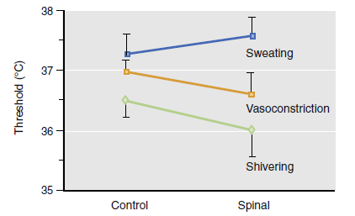

Slide 24
CONSEQUENCES OF MILD INTRAOPERATIVE HYPOTHERMIA
BENEFITS
Hypothermia for brain trauma was initially claimed to be therapeutic based on a post hoc subgroup analysis of a study that overall showed no benefit.
Mild hypothermia markedly reduced infarct size in experimental acute myocardial infarction in animals, and a preliminary study in patients was encouraging . However, a subsequent major outcome trial in humans failed to demonstrate convincing benefit (unpublished).

Slide 25
Major outcome studies have shown that mild hypothermia (≈1° C to 2° C)
(1) triples the incidence of morbid cardiac outcomes
(2) triples the incidence of surgical wound infections
(3) increases surgical blood loss and the need for allogeneic transfusions by approximately 20%
(4) prolongs postanesthesia recovery and the
duration of hospitalization.

Slide 26
PERIOPERATIVE THERMAL MANIPULATIONS
EFFECTS OF VASOMOTOR TONE ON HEAT TRANSFER
Because postoperative thermoregulatory vasoconstriction decreases peripheral-to-core transfer of heat, applied warming is most effective during surgery when patients are vasodilated.
PREVENTING REDISTRIBUTION HYPOTHERMIA
When peripheral tissue temperature is sufficiently increased, subsequent inhibition of normal tonic thermoregulatory vasoconstriction produces little redistribution hypothermia because heat can flow only down a temperature gradient

Slide 27
AIRWAY HEATING AND HUMIDIFICATION
Airway heating and humidification are more effective in infants and children than in adults.
INTRAVENOUS FLUIDS
One unit of refrigerated blood or 1 L of crystalloid solution administered at room temperature each decreases mean body temperature approximately 0.25° C.
CUTANEOUS WARMING
The easiest method of decreasing cutaneous heat loss is to apply passive insulation to the skin surface.
The most common perianesthetic warming system is forced air.

Slide 28
INDUCTION OF MILD THERAPEUTIC HYPOTHERMIA
Typically, target core temperatures are 32° C to 34° C, and it is thought to be important to reach the target temperature quickly.
Administration of refrigerated intravenous fluids also is effective and reduces mean body temperature 0.5° C/L.
Forced-air cooling is easy to implement, but it is relatively slow, taking approximately 2.5 hours to cool neurosurgical patients to 33° C.
The best way to induce therapeutic hypothermia rapidly is probably endovascular cooling. They can decrease core temperatures at rates approaching 4° C/hour.

Slide 29
DELIBERATE SEVERE INTRAOPERATIVE HYPOTHERMIA
Severe hypothermia may be induced deliberately to confer protection against tissue ischemia, specifically during cardiac surgery and, occasionally, neurosurgery.
Increasing evidence indicates that outcomes of bypass surgery, whether on or off pump, are improved by maintaining normothermia or near normothermia.

Slide 30
ORGAN FUNCTION
Hypothermia decreases whole-body metabolic rate by approximately 8%/°C, to approximately half the normal rate at 28° C.
Whole-body oxygen demand diminishes, and oxygen consumption in tissues that have higher than normal metabolic rates, such as the brain, is especially reduced. Brain oxygenation is thus improved by hypothermia.

Slide 31
Cerebral blood flow also decreases in proportion to metabolic rate during hypothermia because of an autoregulatory increase in cerebrovascular resistance.
Hypothermic effects on the heart include a decrease in heart rate, increased contractility, and well-maintained stroke volume.
Hypothermia decreases blood flow to the kidneys by increasing renovascular resistance. As temperature decreases, reabsorption of sodium and potassium is progressively inhibited, causing antidiuretic hormone–mediated “cold diuresis.”

Slide 32
ACID-BASE CHANGES
The pH of neutral water ([OH−] = [H+]) increases 0.017 units for each 1° C reduction in temperature. The pH of blood in a closed system (e.g., test tube or artery) changes similarly.
Interpretation of arterial pH in hypothermic humans is difficult because it is unclear which strategy is optimal.

Slide 33
HYPERTHERMIA AND FEVER
Hyperthermia is a generic term simply indicating a core body temperature exceeding normal values.
In contrast, fever is a regulated increase in the core temperature targeted by the thermoregulatory system.

Slide 34
PASSIVE HYPERTHERMIA AND MALIGNANT HYPERTHERMIA
Passive intraoperative hyperthermia results from excessive patient heating and is most common in infants and children. It is especially frequent when effective active warming is used without adequate core temperature monitoring.
The increase in body temperature during malignant hyperthermia results from an enormous increase in metabolic heat produced by both internal organs and skeletal muscles.

Slide 35
FEVER
Normal body temperature is neither set nor maintained by circulating factors.
In contrast, fever results when endogenous pyrogens increase the thermoregulatory target temperature (“setpoint”).
Identified endogenous pyrogens include interleukin-1, tumor necrosis factor, interferon-α, and macrophage inflammatory protein-1.

Slide 36
Malignant Hyperthermia
Malignant hyperthermia (MH) is a pharmacogenetic disease characterized by extreme hypermetabolism when a genetically susceptible individual is exposed to a triggering agent.
The clinical features are a result of hypermetabolism and include an increase in end-tidal CO2, tachycardia, tachypnea, metabolic acidosis, muscle rigidity, and possibly rhabdomyolysis.
All potent, inhaled halogenated anesthetics and succinylcholine are triggering agents

Slide 37
The final common pathway that leads to MH is uncontrolled release and regulation of calcium in muscle sarcoplasm.
The most effective treatment for an MH episode is dantrolene. Dantrolene may act at multiple sites, including the ryanodine receptor, to inhibit calcium release into the muscle sarcoplasm.
The gold standard for the diagnosis of malignant hyperthermia susceptibility (MHS) is the caffeine–halothane contracture test.

Slide 38
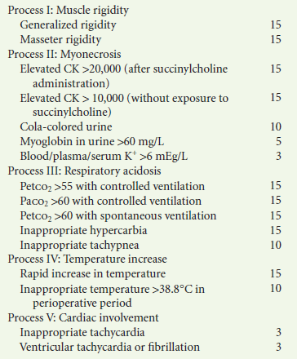
MALIGNANT HYPERTHERMIA CLINICAL GRADING SCALE

Slide 39
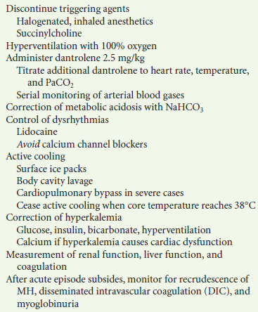
Management of Acute Episode of MH

Slide 40
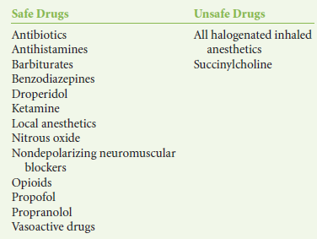

Slide 41
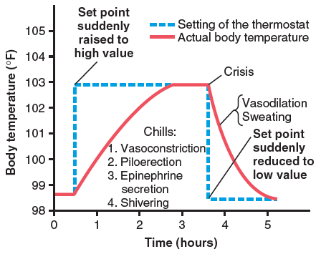

Slide 42
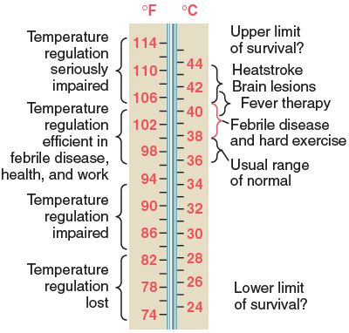

Slide 43
TEMPERATURE MONITORING
Core temperature measurements (e.g., tympanic membrane as measured with a thermocouple, pulmonary artery, distal esophagus, and nasopharynx) are used to monitor intraoperative hypothermia, prevent overheating, and facilitate detection of malignant hyperthermia.
Muscle or skin surface temperatures may be used to evaluate vasomotion, as well as to ensure the validity of peripheral neuromuscular monitoring.
Both core and skin surface temperature measurements are required to determine the thermoregulatory effects of different anesthetic drugs.

Slide 44
TEMPERATURE MONITORING AND THERMAL MANAGEMENT GUIDELINES
The objectives of temperature monitoring and perioperative thermal management are to detect thermal disturbancesand to maintain appropriate body temperature during anesthesia.
1. Core body temperature should be measured in most patients given general anesthesia for longer than 30 minutes.
2. Temperature should also be measured during regional anesthesia when changes in body temperature are intended, anticipated, or suspected.
3. Unless hypothermia is specifically indicated (e.g., for protection against ischemia), efforts should be made to maintain intraoperative core temperature higher than 36° C.

Slide 45
Devices to Measure Temperature
Non-Electrical Methods
Liquid Expansion Thermometers
Mercury Thermometer
Alcohol thermometer
2. Dial Expansion Thermometer
Bimetallic Strip Thermometers
Bourdon ( Pressure ) Gauge Thermometers
3. Chemical Thermometers

Slide 46
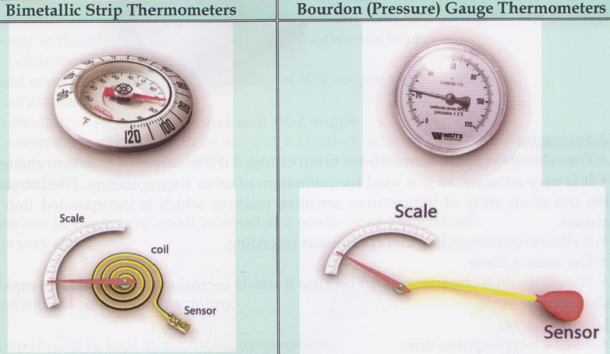

Slide 47
Electrical Methods
Resistance Thermometer
Thermistor
Thermocouple
Transistor Thermometer
Crystal Resonators Thermometers
Optical Thermometers
Types of Detectors
- Temperature Sensitive Detector
- Photon Sensitive Detector
Types - Infrared Ear Thermometer
- Tympanic Membrane Thermometer
- Thermography

Slide 48
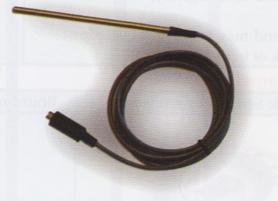
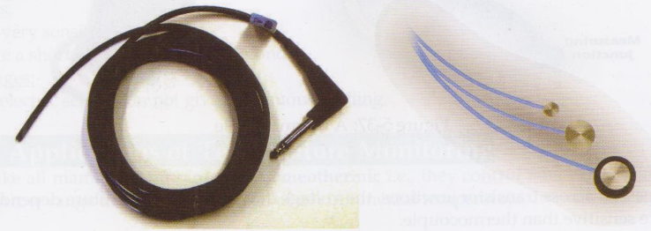
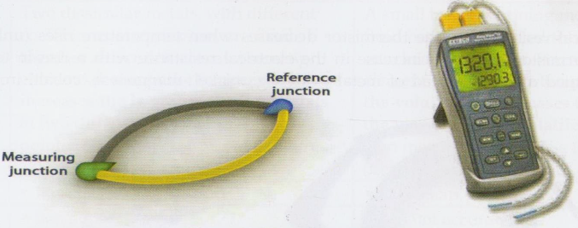
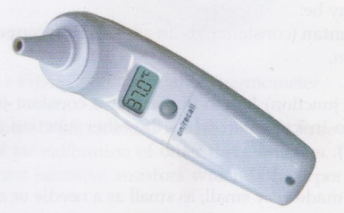

Slide 49
TEMPERATURE MONITORING SITES
The core thermal compartment is composed of highly perfused tissues whose temperature is uniform and high Compared with the rest of the body. Temperature in this compartment can be evaluated in the pulmonary artery, distal esophagus, tympanic membrane, or nasopharynx.
Core temperature can be estimated with reasonable accuracy using oral, axillary, rectal, and bladder temperatures, except during extreme thermal perturbations.
Skin surface temperatures are considerably lower than core temperature.
Temperature = (0.85 * Core body temperature) + ( 0.15 * Skin Temperature)

Slide 50
Urine output monitoring
Indications:
1. Urinary bladder catheterization is the only reliable method of monitoring urine output.
2. Insertion of urinary catheter is indicated in patients with congestive heart failure, renal failure, advanced hepatic disease Or Shock.
3. Lengthy surgeries and intra operative diuretic administration are other indications.
4. Post operative bladder catheterization is indicated in patients having difficulty voiding in the recovery room after general or regional anaesthesia.

Slide 51
Contraindications
Bladder catheterization should be done with utmost care in patients at high risk for infections.

Slide 52
Techniques and Complications
A soft rubber foleys catheter is inserted into the bladder transurethrally and connected to a disposable calibrated collection chamber.
To avoid urine reflux and minimize the risk of infection, the chamber should remain at a level below the bladder.

Slide 53
Complications
Complications of catheterization includes urethral trauma and UTI.
Rapid decompression of the distended bladder can cause hypo tension.
Suprapubic catheterization of the bladder with plastic tubing inserted through a large bore needle easy an alternative.

Slide 54
Clinical considerations
Urine output is a reflection of kidney perfusion and function and an indicator of renal, cardiovascular, fluid volume status.
Inadequate urine output(oliguria) is often arbitrarily defined as urinary output of less than 0.5 ml/kg per hour, but actually is a function of patients concentrating ability and osmatic load.

Slide 55
Clinical considerations
Urine electrolyte composition, specific gravity and osmolality aid in the differential diagnosis of oliguria.
References: Michael & Morgan 8th Edition.

Slide 56
REFERENCES
Miller’s Anesthesia, 8E
Barash Clinical Anesthesia Textbook, 7E
Guyton and Hall Textbook of Medical Physiology, 13E

Slide 57
Thank You

